Slide 1



THE QUOTES THAT WILL INFLUENCE MANY
M-MIND H-HEART
S - SOUL

Slide 2


Slide 3

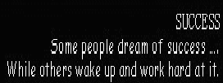

Slide 4


Slide 5
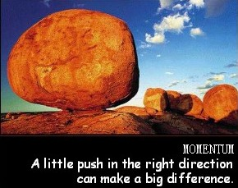

Slide 6


Slide 7
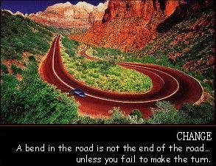

Slide 8


Slide 9


Slide 10


Slide 11


Slide 12
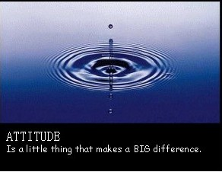

Slide 13
